Slide 1

Computer Graphics
1
2/9/2023

Slide 2

What you will learn from Computer
Graphics
2
 Fundamentals of computer graphics algorithms
 You will implement the algorithms learnt in this course
 We will concentrate on 2D basically
 We may explore some 3D concepts later
 Basics of scan-line conversion algorithms
 Draw graphical primitives
 Hidden surfaces
 You will get the chance to use your programming experience
2/9/2023

Slide 3
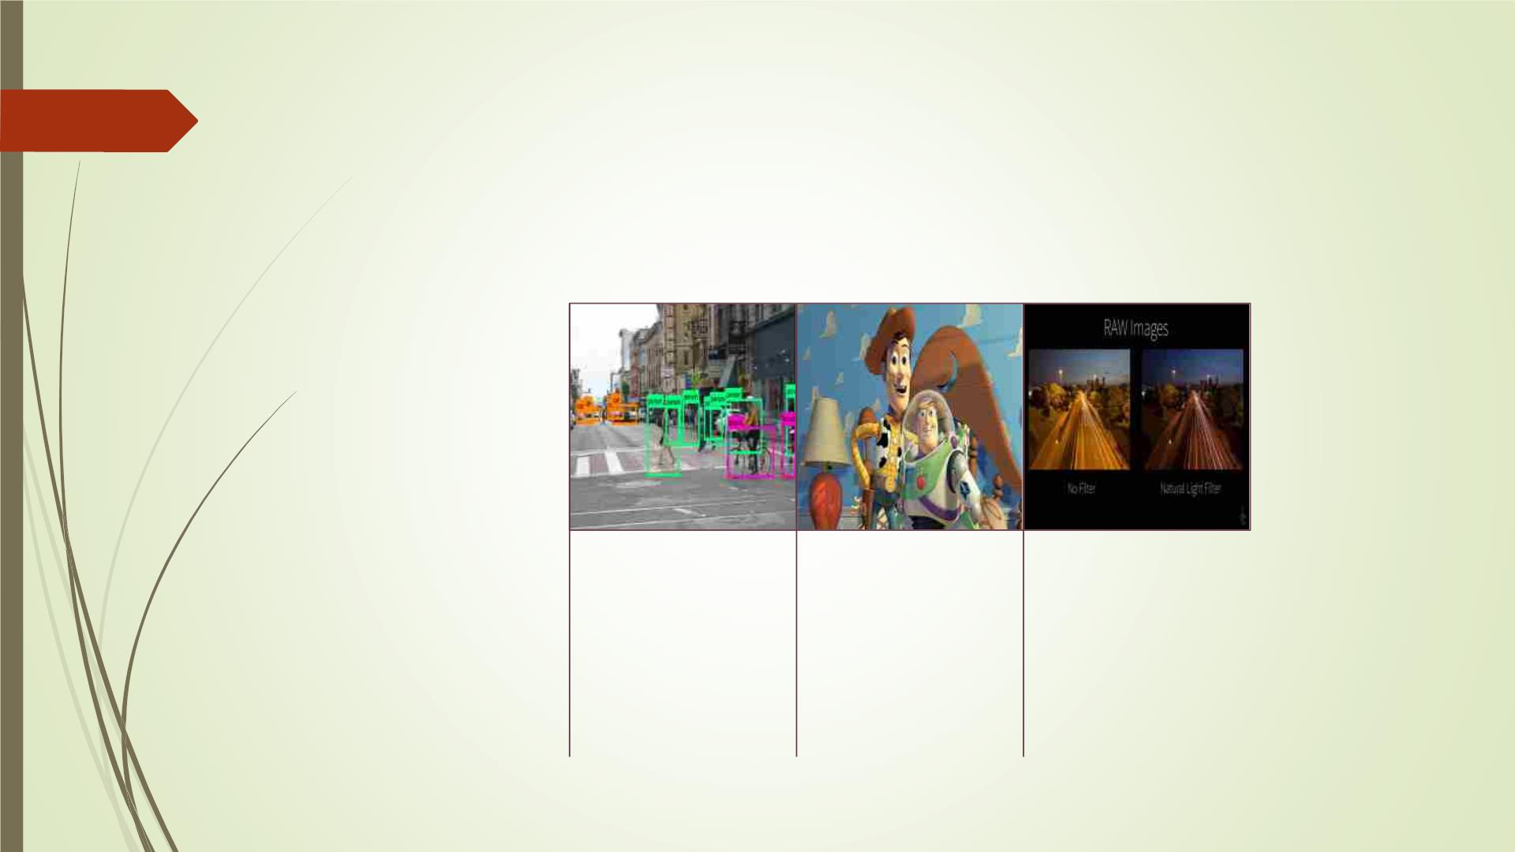
Computer graphics: what does it
mean?
3
Computer vision:
extracting
Computer graphics:
creating an image
Digital image
processing:
information from the from scratch using
contents of an input computer.
image or video frame.
processing raw input
image to perform
different operations.
Ex: animated movie
Ex: face recognition
Ex: apply filter on an
image
2/9/2023

Slide 4

Applications of Computer
Graphics
4
2/9/2023

Slide 5
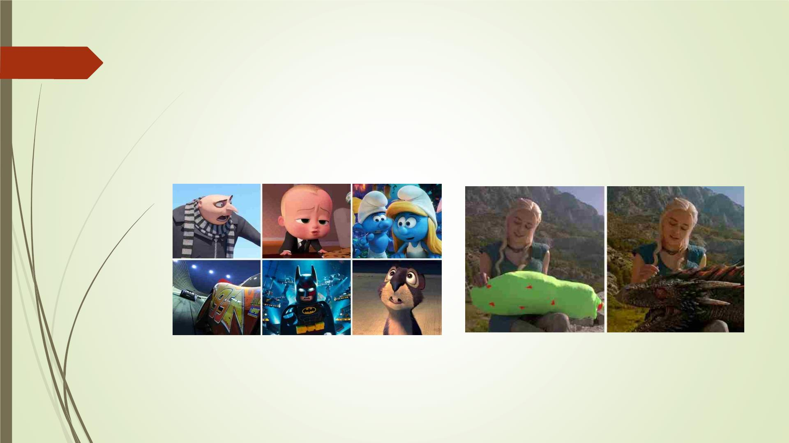
Movies/ special effects
5
2/9/2023

Slide 6
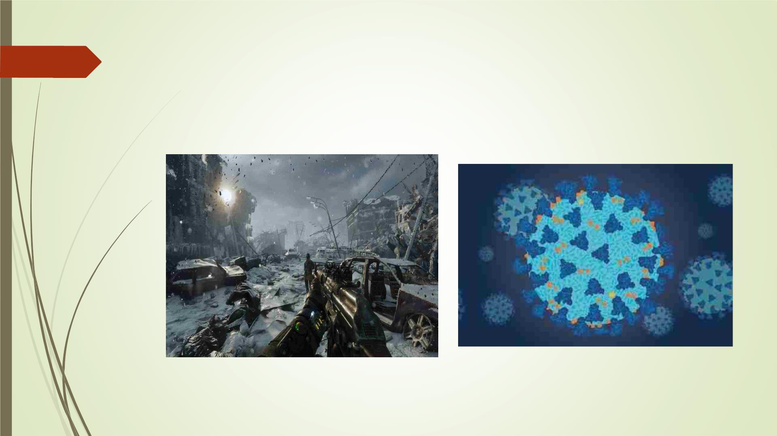
Video games and Simulation
6
Image: Megan Murrell
2/9/2023

Slide 7
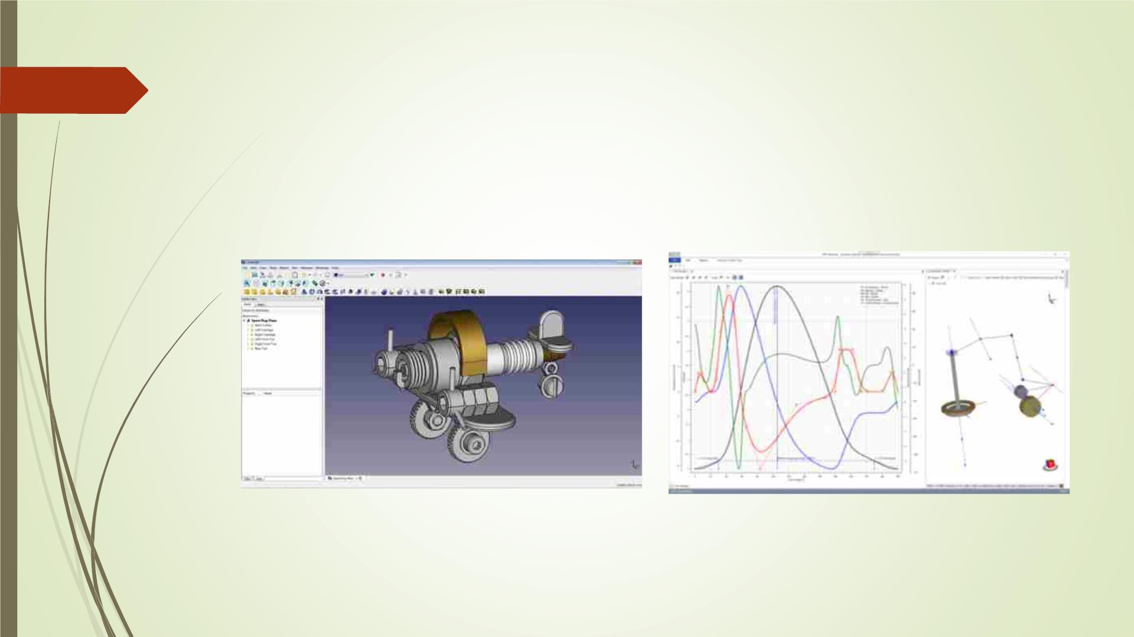
CAD-CAM & Design
7
2/9/2023

Slide 8
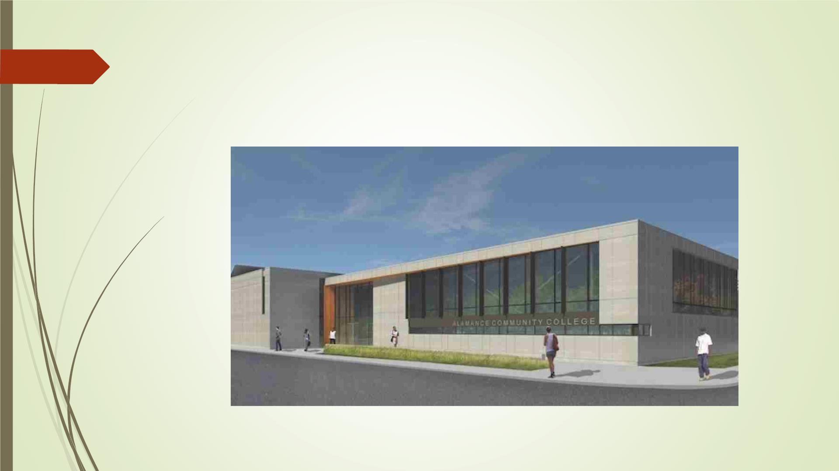
Architecture
8
2/9/2023

Slide 9
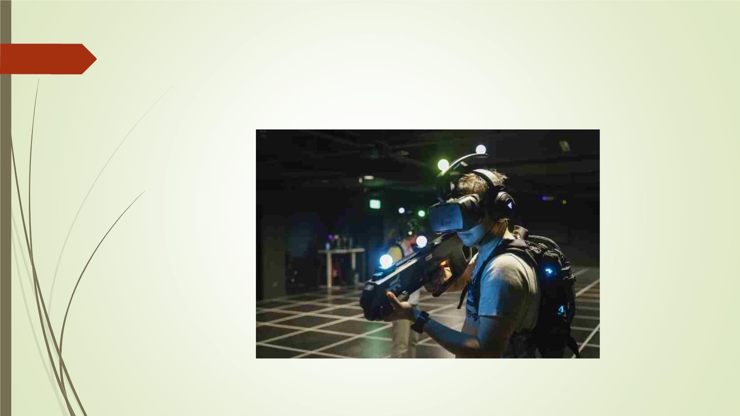
Virtual reality
9
2/9/2023

Slide 10
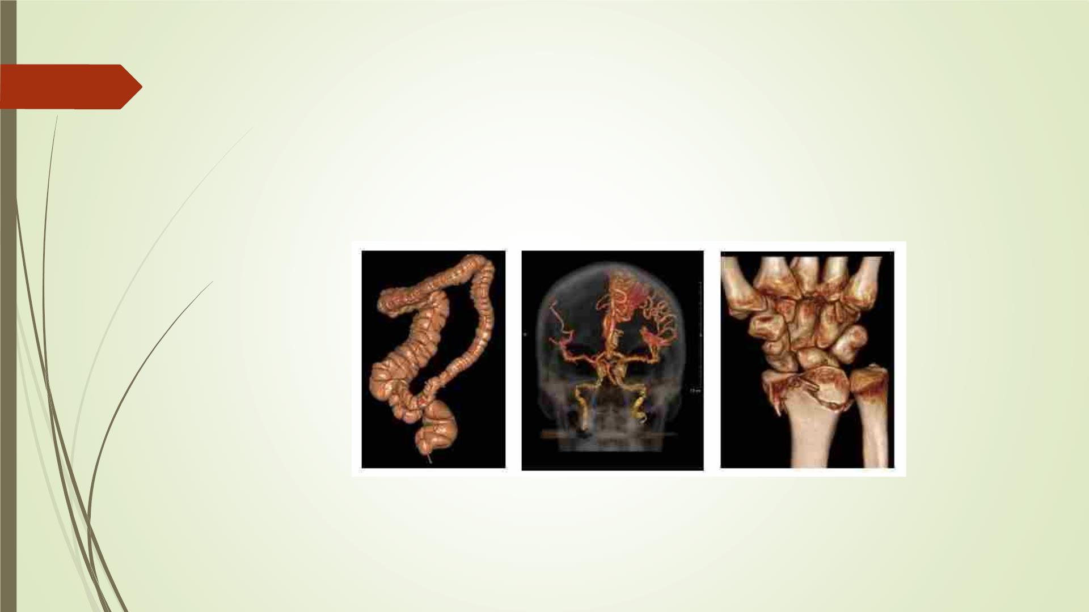
Medical imaging
10
2/9/2023

Slide 11

Education
11
2/9/2023

Slide 12
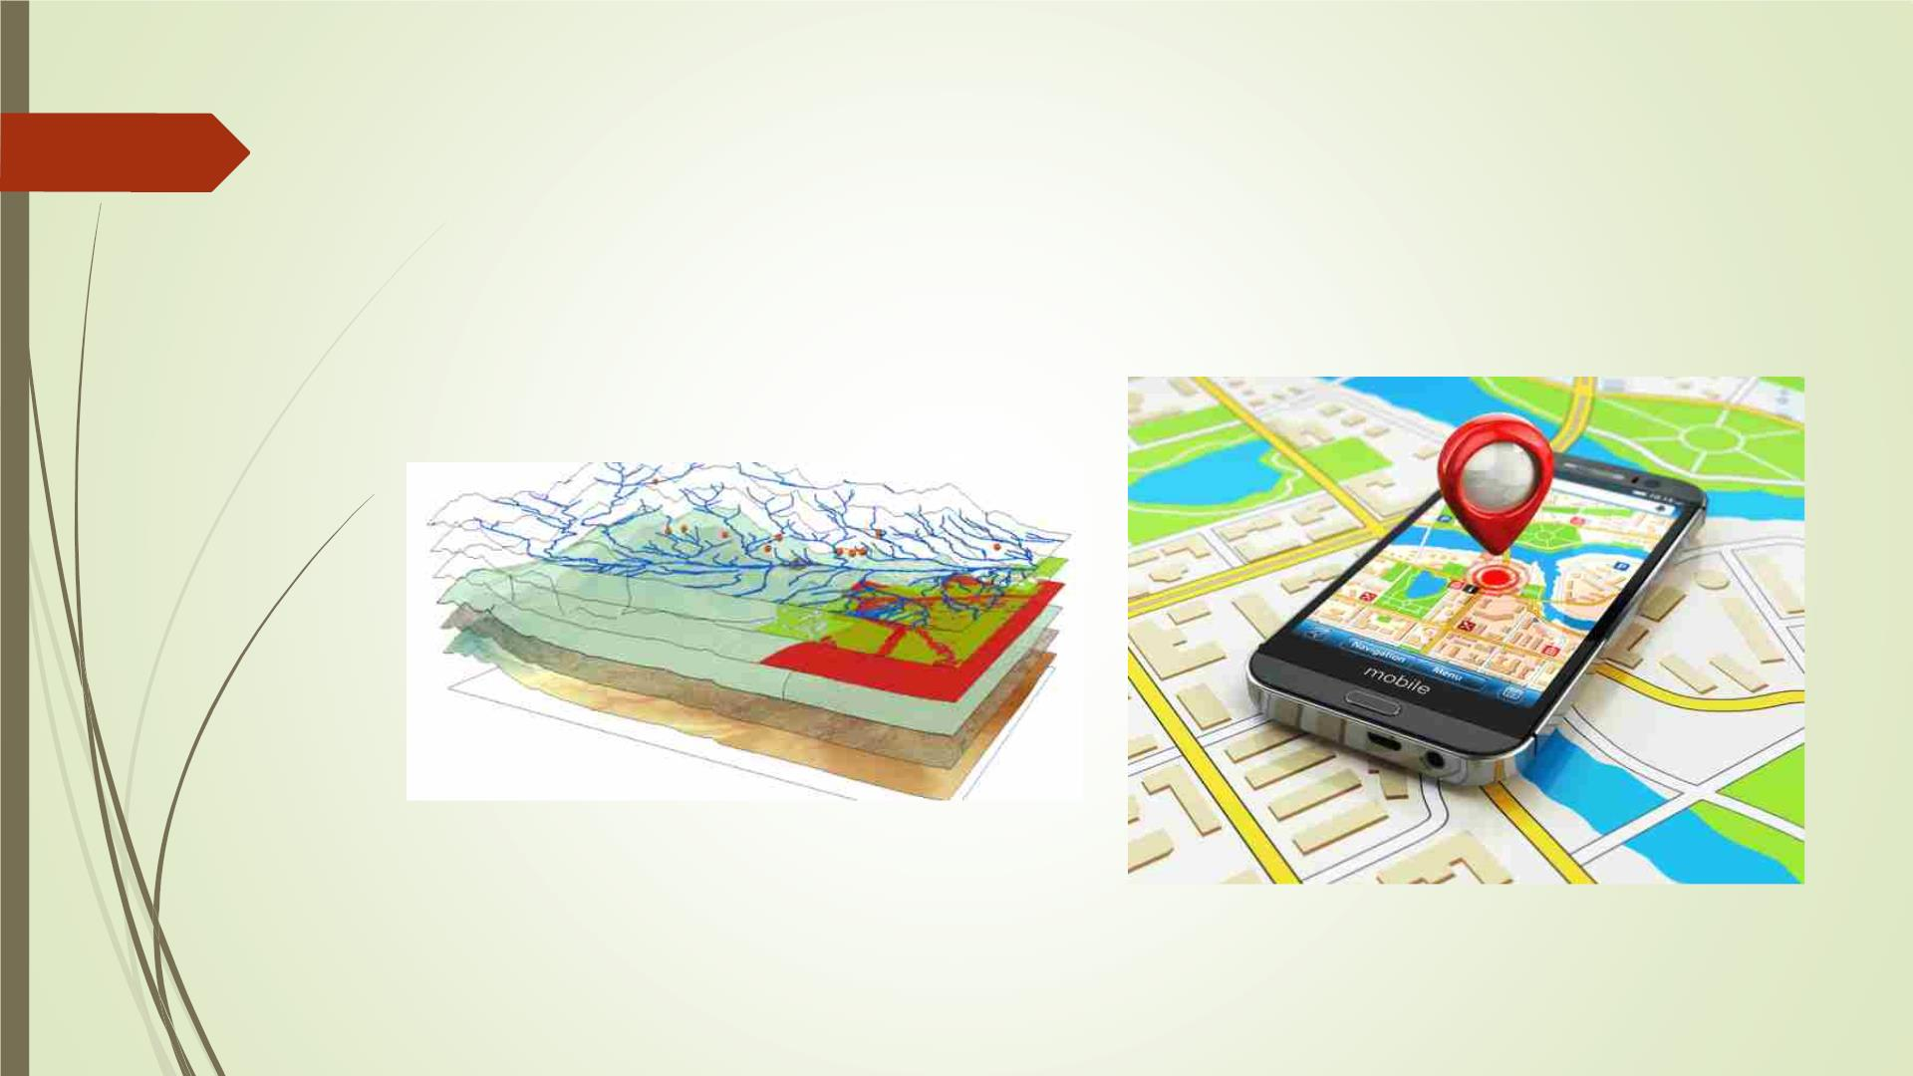
Geographic info systems & GPS
12
2/9/2023

Slide 13
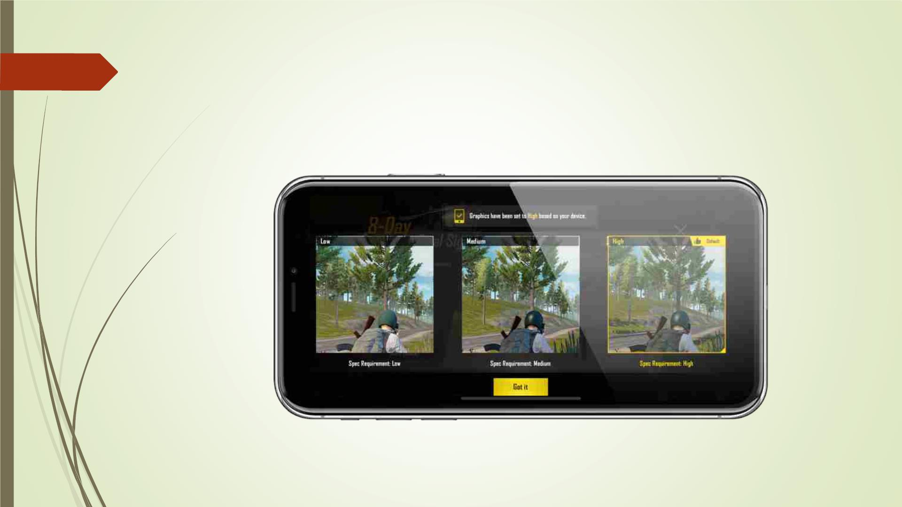
Any display
13
2/9/2023

Slide 14
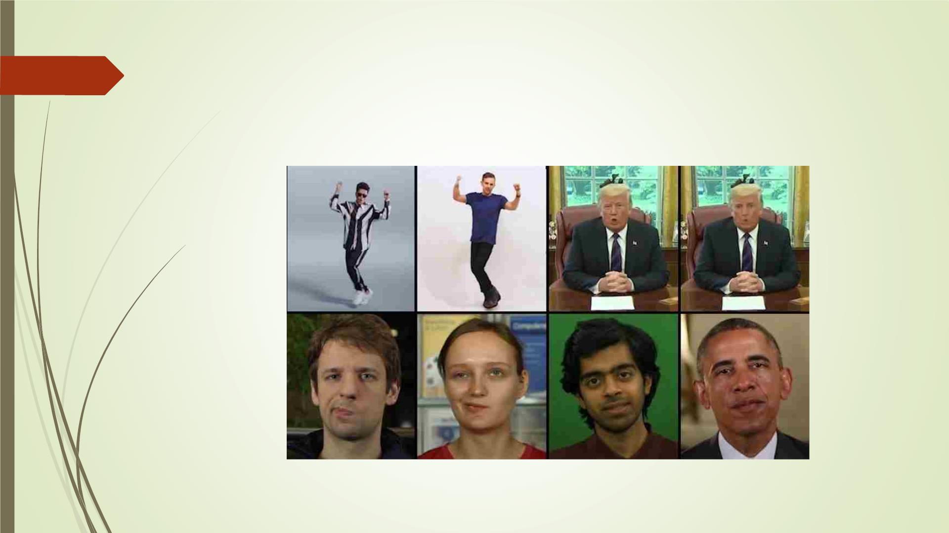
Deepfakes
14
2/9/2023

Slide 15
How much math?
15
 Lots of simple linear algebra
 Get it right, it will help you a lot!
 Some more advanced concepts
 Homogenous coordinates
 Differential equations
 To implement the algorithms
2/9/2023

Slide 16
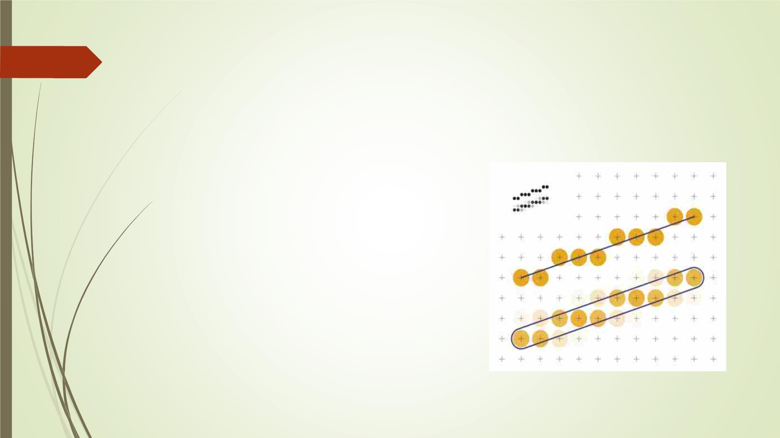
Scan-line conversion algorithms
16
 Line Drawing Algorithms
 DDA
 Midpoint
 Midpoint with eight way symmetry
 Circle Drawing Algorithm
 Midpoint
 Polygon Filling Algorithm
2/9/2023

Slide 17
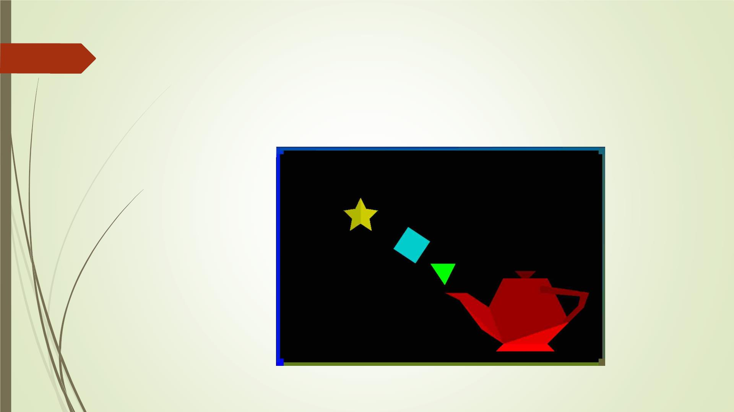
Scan-line polygon filling algorithm
17
2/9/2023

Slide 18
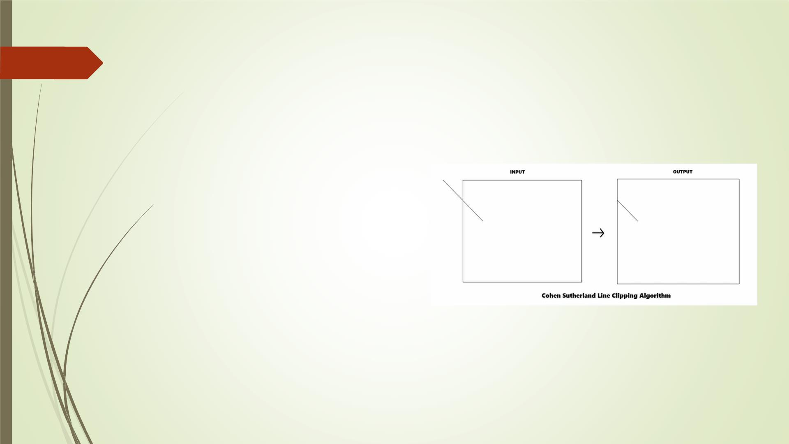
Clipping algorithms
18
 Line clipping algorithms
 Cohen-Sutherland
 Cyrus-Beck
 Polygon clipping algorithm
 Sutherland-Hodgman
2/9/2023

Slide 19
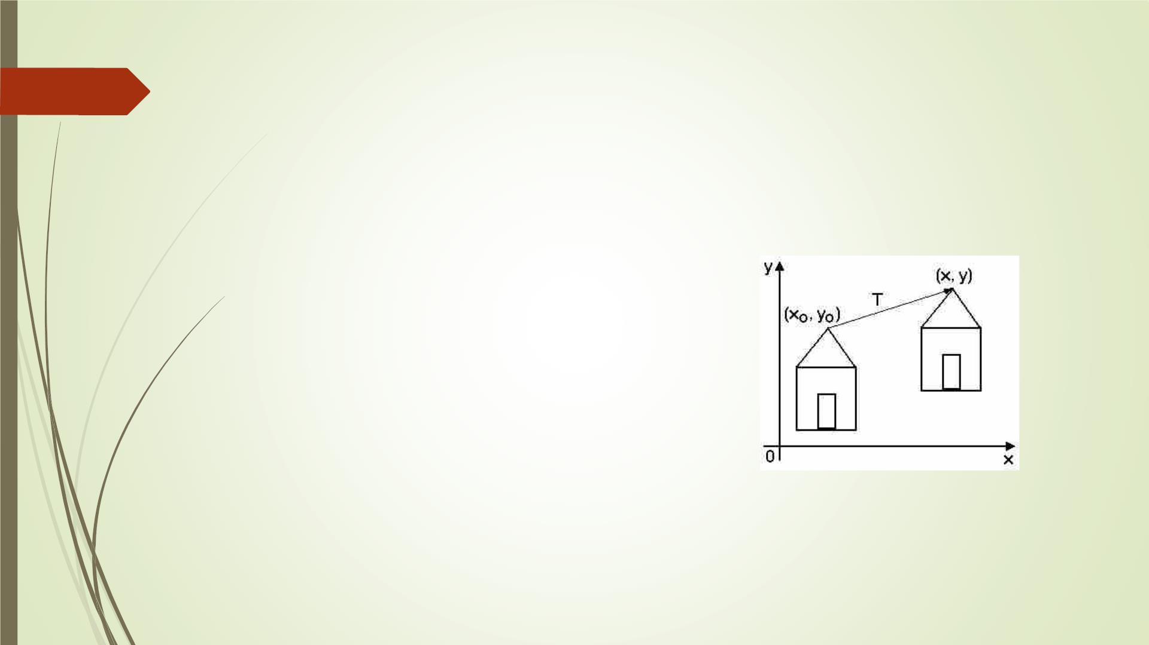
Transformation
19
 Translation
2/9/2023

Slide 20
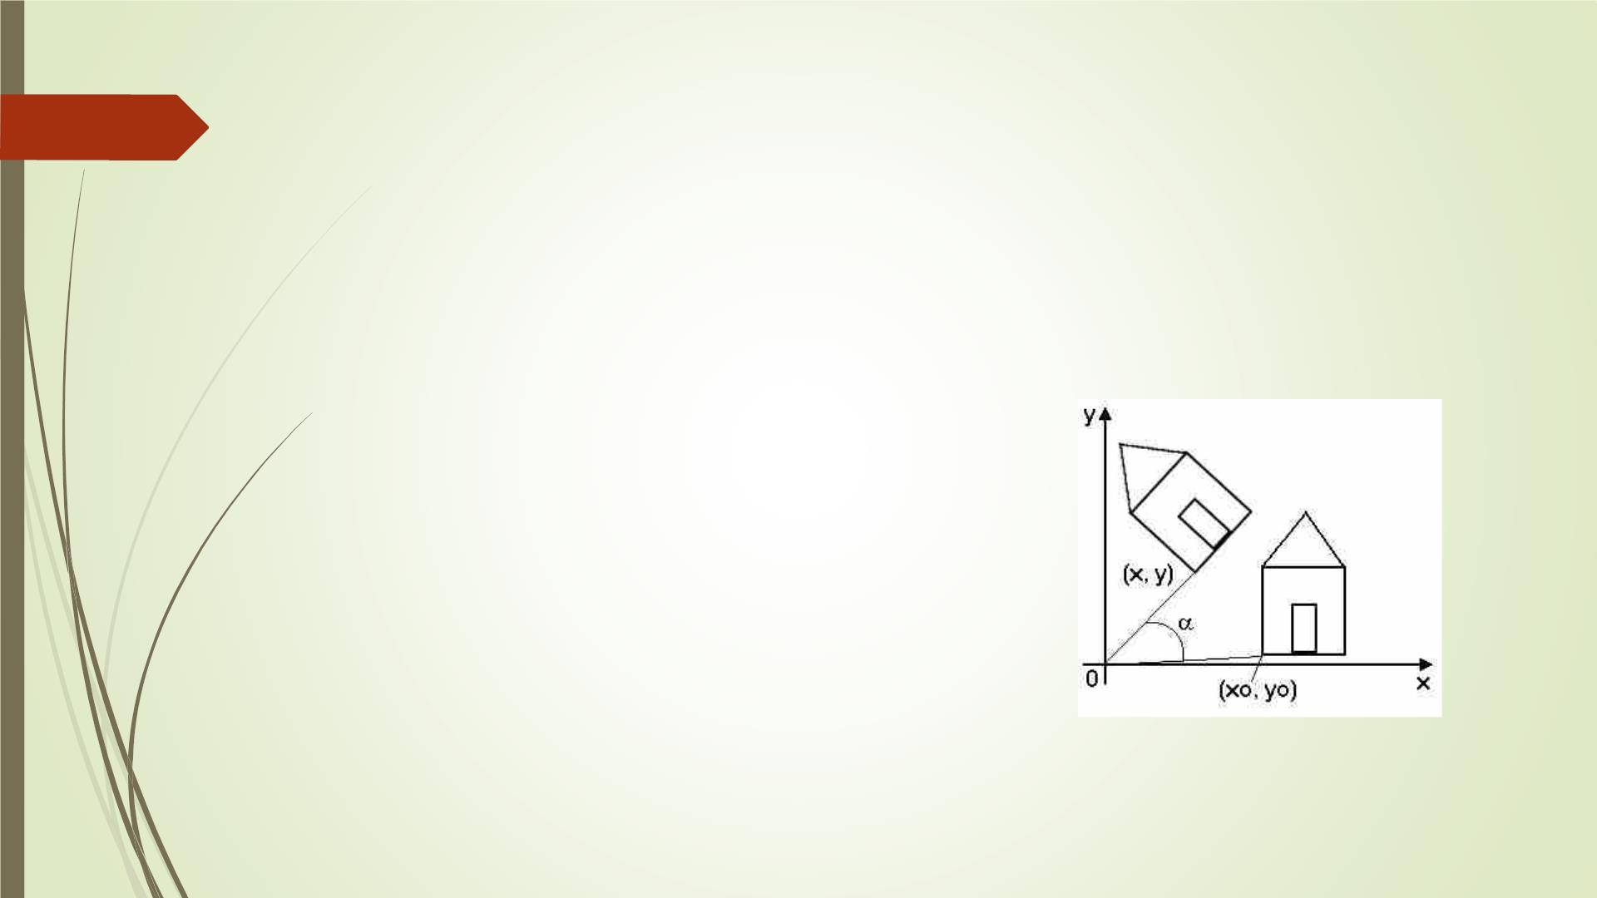
Transformation
20
 Rotation
2/9/2023

Slide 21
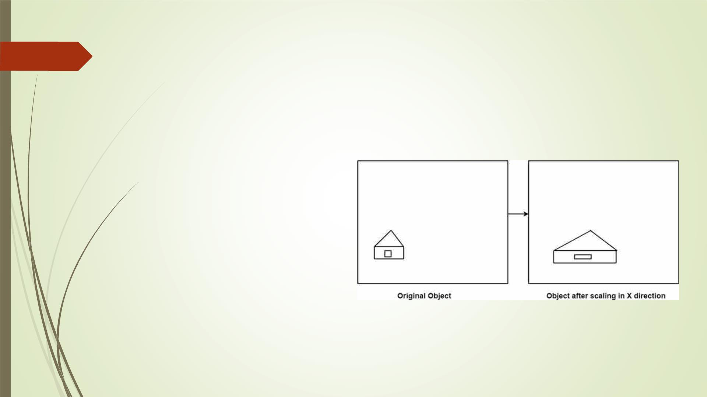
Transformation
21
 Scaling
2/9/2023

Slide 22
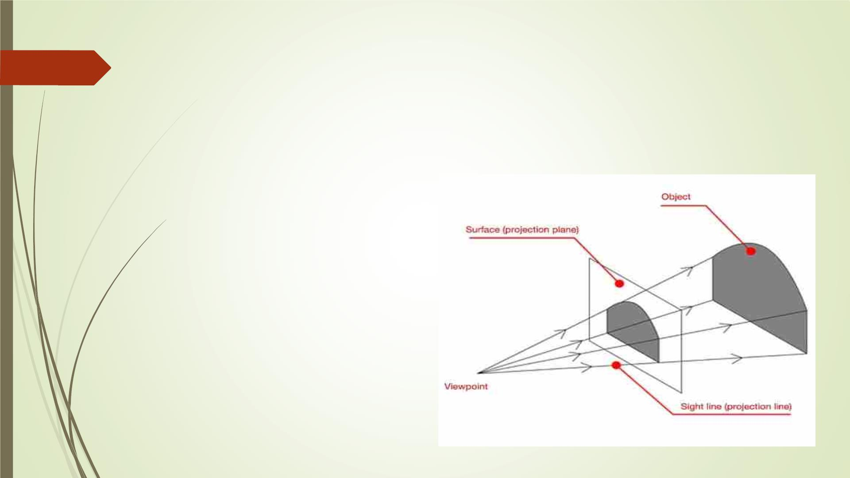
Projection
22
 Perspective projection
2/9/2023

Slide 23
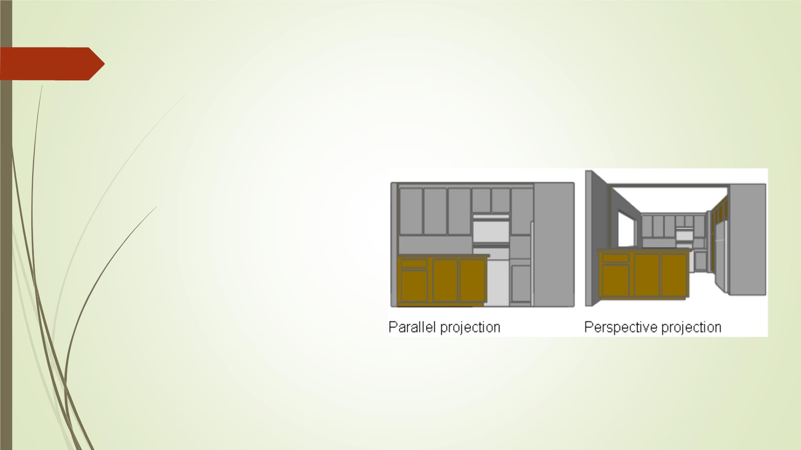
Projection
23
 Parallel projection
2/9/2023

Slide 24
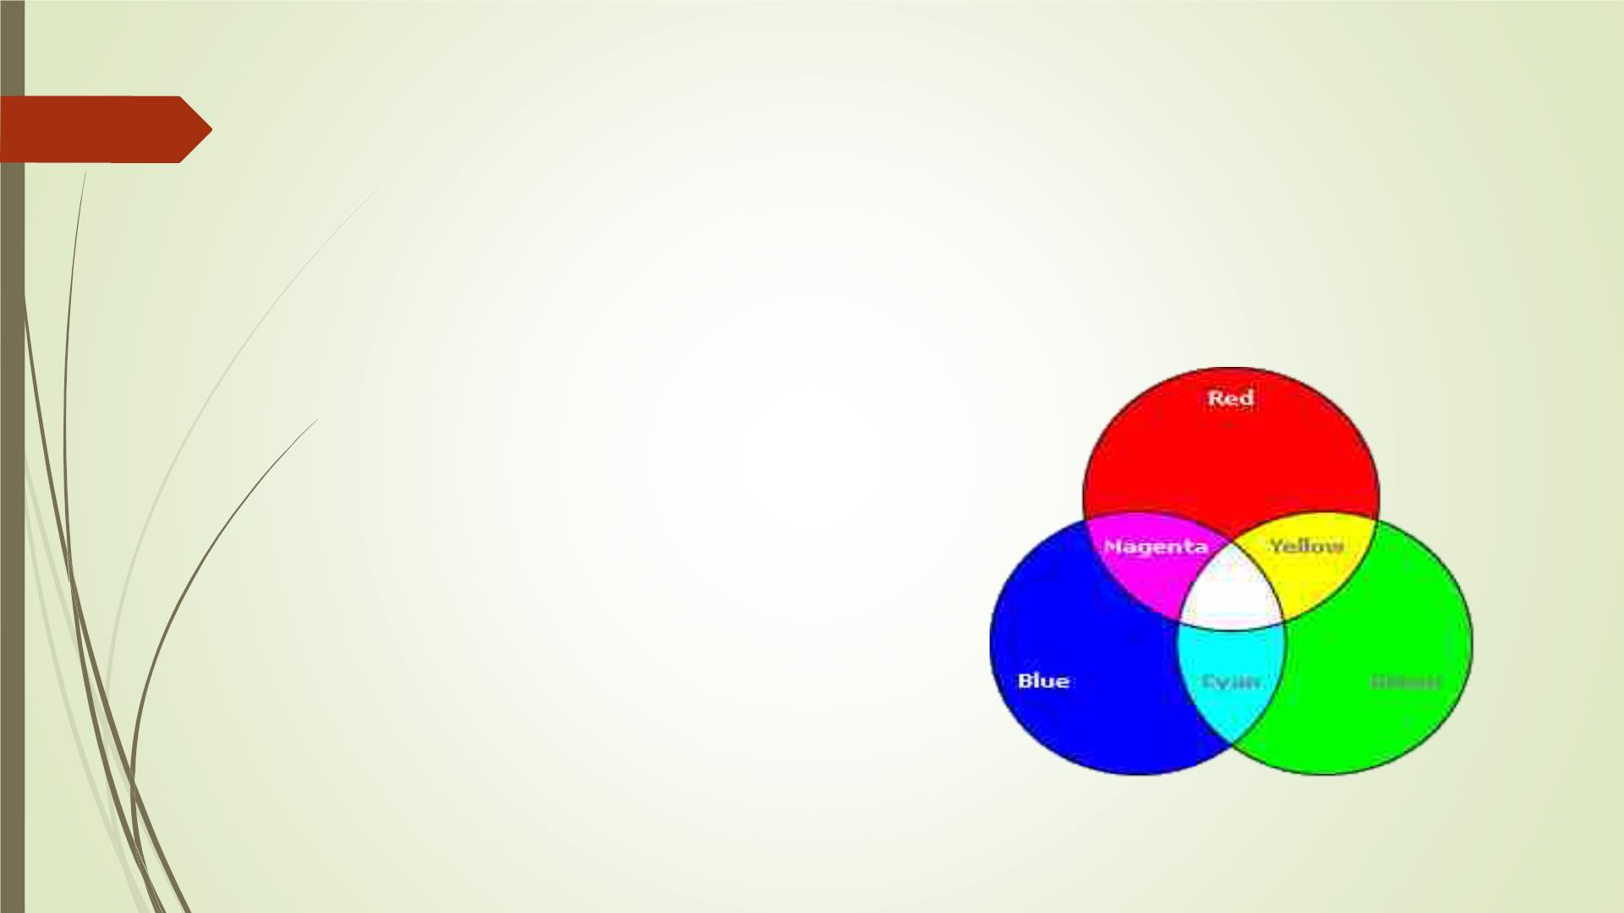
Color models
24
 RGB – Red Green Blue
 HSV – Hue Saturation Value
 HSL – Hue Saturation Lightness
2/9/2023

Slide 25
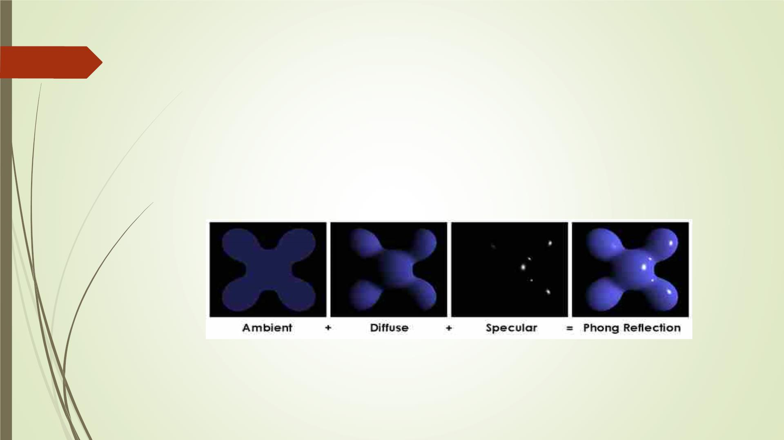
Illumination models
25
 Global illumination
 Diffuse reflection
2/9/2023

Slide 26
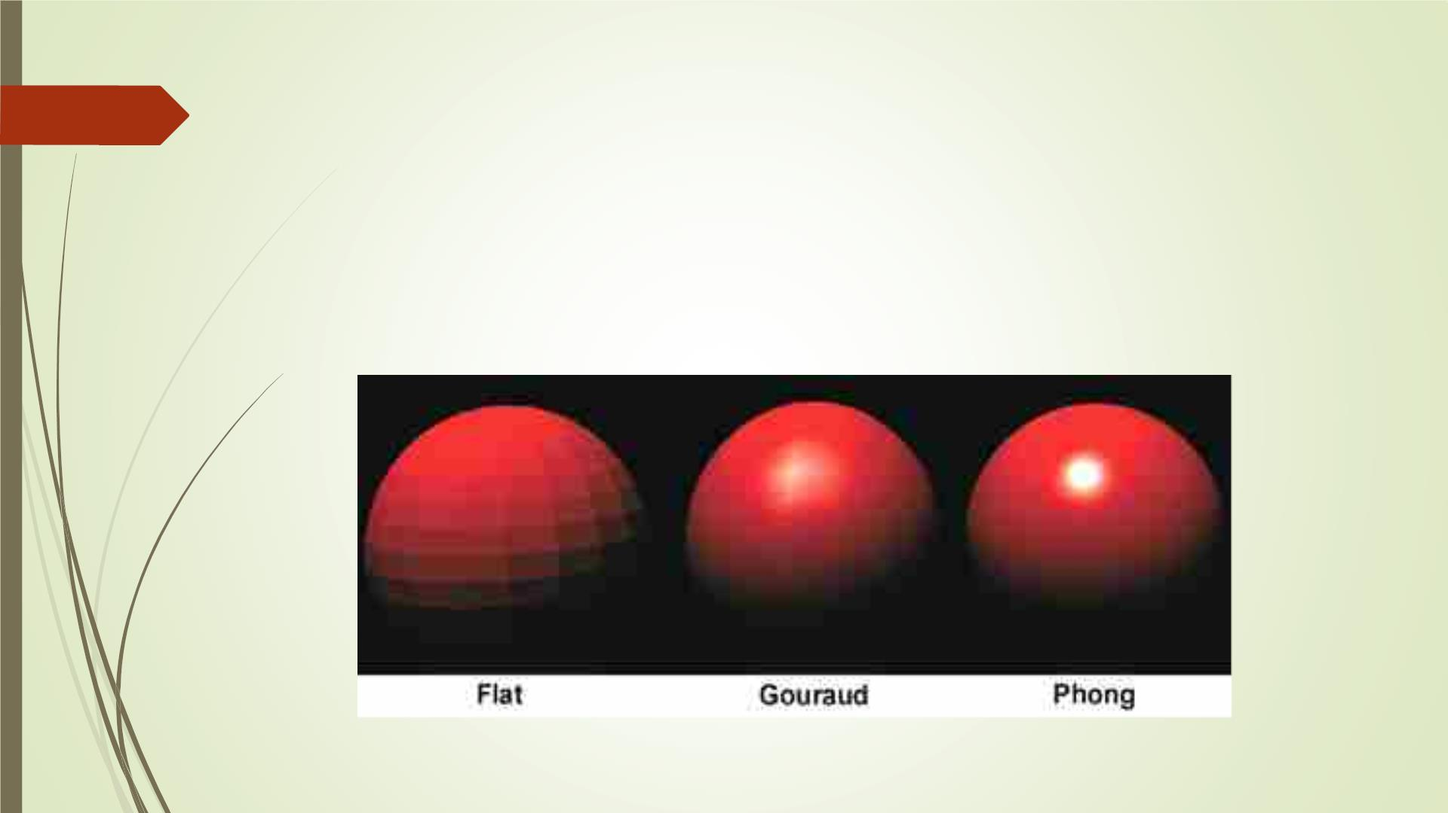
26 Shading:
While at Gouraud shading the light is calculates per
vertex (Vertex shader), at Phong shading the light is
calculates per fragment (fragment shader).
2/9/2023

Slide 27
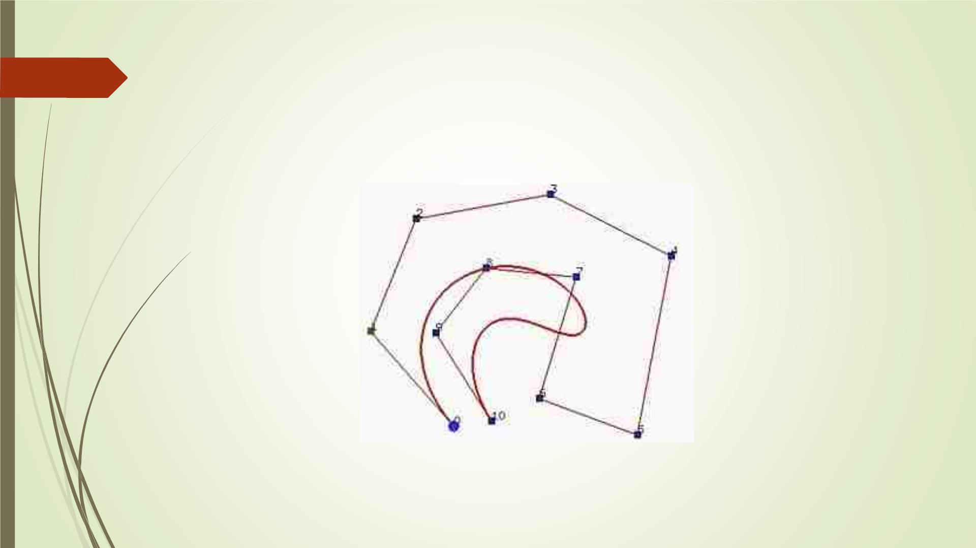
Curves & Splines
27
2/9/2023

